Slide 1
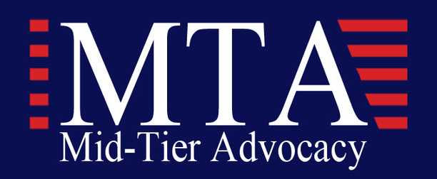
Infrastructure
Roundtable
Mid-Tier Advocacy and Peter Damon Group Host a discussion about President Biden's new Infrastructure Law which has created unprecedented opportunities for small, mid and disadvantaged businesses

Slide 2
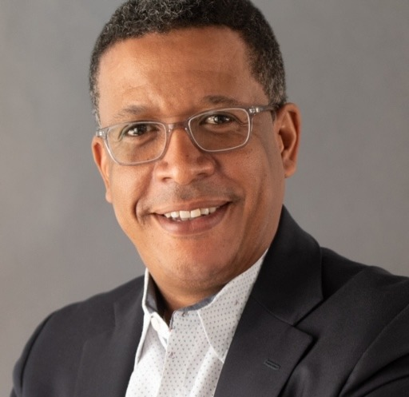
Welcome
Mr. Darren Peters, Founder and Managing Partner of the Peter Damon Group Inc.
Darren Peters is the Founder and Managing Partner for the DC-based public affairs, event management and business development consulting firm, Peter Damon Group (PDG).
Mr. Peters has worked in the Minority Business Development Agency at the U.S. Department of Commerce, the White House Office of Presidential Personnel and as the Chief of Staff for the Department of Energy’s Policy and International Affairs Office.

Slide 3
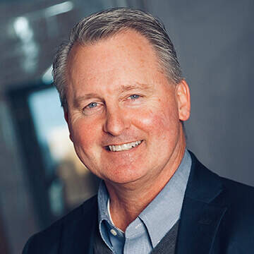
Remarks
Mr. Bryan Davis, President Mid-Tier Advocacy Inc.
Bryan Davis is the Vice President of Government Affairs and Community Engagement for SupplyCore. In this role, his responsibilities include advocacy for a wide array of policy issues on Capitol Hill and with the Executive Branch. Mr. Davis works with state and local government to advance
Additional advocacy efforts include relationship building with legislators, executive branch officials, state and municipal officials and maintaining an active and constructive role in DC-based coalitions and associations, to include Mid-Tier Advocacy.

Slide 4
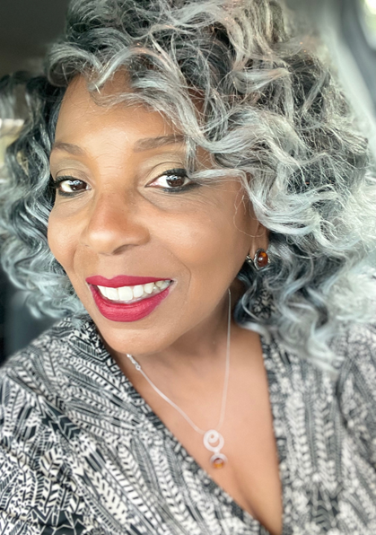
Moderator
Ms. Tonya, Founder & Chairman Mid-Tier Advocacy Inc.
Mid-Tier Advocacy, Inc. (MTA) was established to work toward the elimination of the competitive disadvantage facing small emerging and mid-tier government support services companies. As a 501(c)3 nonprofit, nonpartisan organization, MTA works to increase awareness of the challenges facing businesses that are no longer considered small due to the fact that they have outgrown their current size standards.
MTA leverages the collective voice of its members to influence federal policies that impact their growth and sustainability.

Slide 5
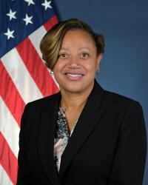
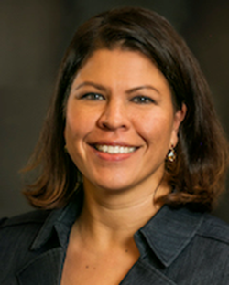
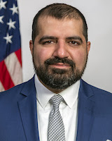
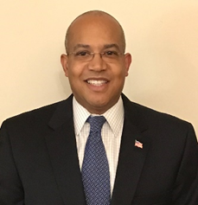
Panelists
Ms. Shelby Scales
Ms. Nina Albert
Mr. Sonny Hashmi
Mr. John Hale III
Dept. of Transportation
Director (OSDBU)
GSA Commissioner
for Public Building Service
GSA Commissioner for Federal Acquisition
Service
The Cornerstone Group “Former Director“
Dept. of Energy (OSDBU)

Slide 6
Ms. Shelby Scales
Shelby M. Scales serves as the Director of the Office of Small and Disadvantaged Business Utilization (OSDBU). Ms. Scales has 21 years in small business development and diversity inclusion. Scales, an entrepreneurial advocate, is the former Director of the Office of Civil Rights with North Carolina Department of Transportation where she administered civil rights programming for all modes of transportation.
She also served as President & CEO of the Airport Minority Advisory Council (AMAC), an organization established nearly 30 years ago to promote the full participation of minorities and women in the aviation and airport contracting environment. She leveraged her leadership skills among the AMAC board of directors, its staff and members, and airports executives, affiliated organizations, and legislative leaders.

Slide 7
Ms. Shelby M. Scales
Department of Transportation,
Director of the Office of Small and Disadvantaged Business Utilization (OSDBU)
www.reallygreatsite.com
Presented By : Larana Corporate

Slide 8
Small Business Briefing on
Bipartisan Infrastructure Law
MTA Small Business Roundtable
March 29, 2022
Shelby M. Scales, Director

Slide 9
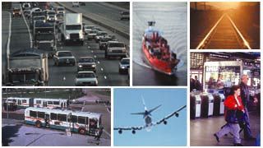
Organization
Secretary Buttigieg’s Top Priorities – Safety, Innovation and Infrastructure
10 Operating Administrations (OA)
Different mission based on industry focus
DOT employs 55,000 people across the country
OSDBU Director – Member of Secretary’s Executive Team
Support DOT’s Disadvantaged Business Enterprise program

Slide 10
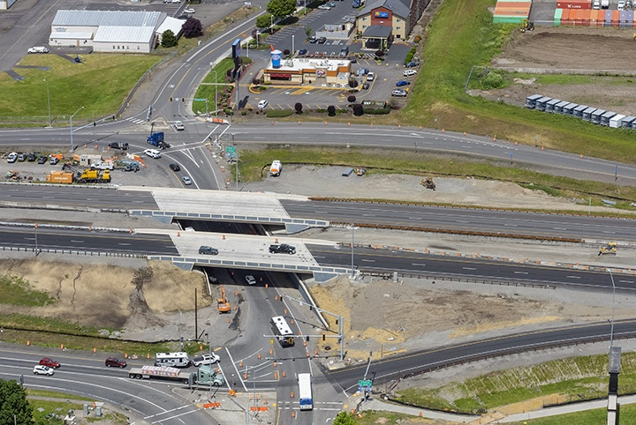
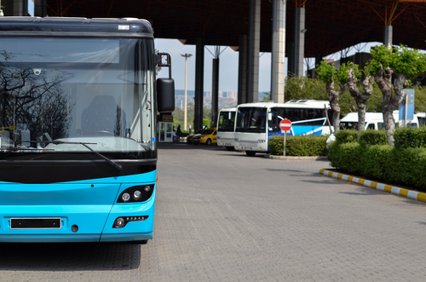
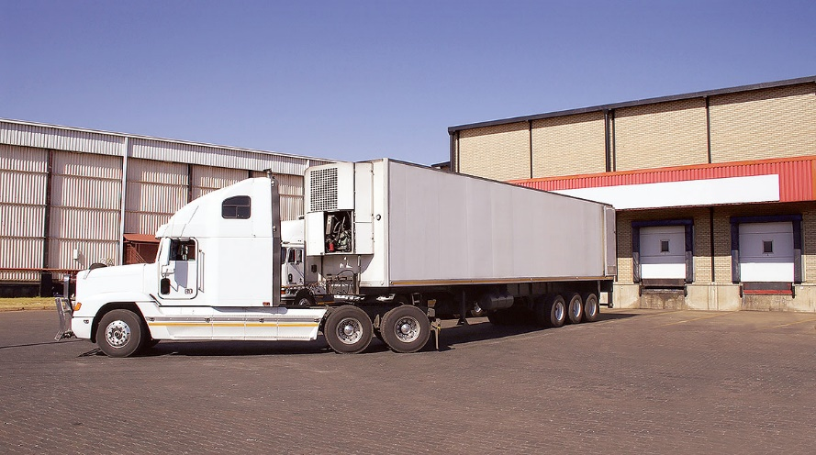
Operating Administrations
Office of the Secretary
Federal Aviation Administration
Federal Highway Administration
National Highway Traffic Safety Administration
Federal Railroad Administration
Federal Transit Administration
Maritime Administration
Federal Motor Carrier Safety Administration
Pipeline Hazardous Materials Safety Administration
Great Lakes Saint Lawrence Seaway Development Corporation

Slide 11
Bipartisan Infrastructure Law Will…
Deliver clean water to millions households and schools and replace all of the nation’s lead pipes and service lines
Ensure every American has access to reliable, affordable high-speed internet
Build out the first-ever national network of Electric Vehicle charging infrastructure
Rebuild economically significant bridges in communities across the country
Make the largest investment in public transit in history and largest investment in rail since Amtrak’s creation
Make our communities safer and our infrastructure more resilient to the impacts of climate change and other threats.
Build thousands of miles of new transmission power lines to facilitate the expansion of renewable energy

Slide 12
The Infrastructure Investment and Jobs Act in Brief
Top areas of investment:
Roads, Bridges, and Major Projects
$110 Billion
Transportation Safety
$11 Billion
Public Transit
$89.9 Billion
Passenger and Freight Rail
$66 Billion
Electric Vehicles and Buses
$15 Billion
Airports, Ports, and Waterways
$42 Billion
Environmental Remediation and Power Infrastructure
$86 Billion
Other Areas of Investment
$121 Billion

Slide 13
Follow the Money
Infrastructure Law
Direct Contracts
Awards by OAs
Federal Acquisition Regulations & FAA’s Acquisition Management System
Grants
Small Business Goals
State DOTs
Transit Authorities
Airports
State & Local Acquisition Regulations
Disadvantaged Business Enterprises (DBE)
USDOT Appropriated Budget

Slide 14
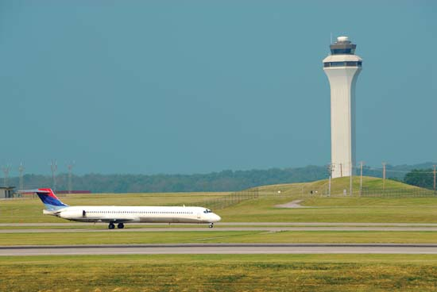
BIPARTISAN INSFRASTRUCTURE LAW (BIL)
Grants to States, Transit and Airport Authorities
Targeted outreach to DBEs and underserved communities
Master Class Capacity Building
Regional Small Business Summit & Matchmaking
Direct contract opportunities (Next 5 Years)
FAA - $5B Air Traffic Facilities
DOT-wide - $1B Contract support
One-DOT approach Coordination – OSDBU, DOCR and Procurement
Procurement Forecast
Strategic stakeholder engagement
Federal agencies
Trade Associations, Chambers of Commerce
Industry

Slide 15
Available Competitive Grants Programs for State & Local Governments
Safe Streets for All ($6B, new)
Rebuilding American Infrastructure with Sustainability and Equity (RAISE) Grants ($15B, expanded)
Infrastructure for Rebuilding America (INFRA) Grants ($14B, expanded)
Federal Transit Administration (FTA) Low and No Emission Bus Programs ($5.6B, expanded)
FTA Buses + Bus Facilities Competitive Program ($2.0B, expanded)
Capital Investment Grants (CIG) Program ($23B, expanded)
Federal Aviation Administration (FAA) Terminal Program ($5B, new)
MEGA Projects ($15B, new)
Promoting Resilient Operations for Transformative, Efficient, and Cost-saving Transportation (PROTECT) Program ($8.7B, new)
Port Infrastructure Development Program ($2.25B, expanded)
5307 Ferry Program ($150M, existing)
Electric or Low Emitting Ferry Program ($500M, new)
Rural Ferry Program ($2B, new)

Slide 16
BIL at a glance (Florida)
$13.3 billion over five years in Federal highway formula funding for highways and bridges.
Over five years, Florida will receive approximately $100 million in formula funding for highway safety traffic programs to help improve driver behavior and reduce deaths and injuries from motor vehicle-related crashes.
Motor Carrier Safety Assistance Program (MCSAP) formula grant - Approximately $103.7 million over five years in funding to augment commercial motor vehicle (CMV) safety efforts to reduce CMV crashes
Florida would expect to receive about $2.8 billion over five years to improve public transportation options
Electric Vehicle Charging Stations –
$198 million over five years to support the expansion of an EV charging network in the state
Opportunity to apply for grants out of the $2.5 billion available for EV charging program
Freight rail efficiency and safety
Eligible to compete for $10 billion for rail improvement and safety grants, and
$5.5 billion for grade crossing safety improvements.
Airport Improvements - Approximately $1.2 billion for infrastructure development for airports over five years
Florida Fact Sheet

Slide 17
FY20 TOP 10 NAICS CODES
6 Digit NAICS Code (Description) | Total Dollars
541330 (ENGINEERING SERVICES) | $1,314,399,218.80
336611 (SHIP BUILDING AND REPAIRING) | $685,630,119.19
541512 (COMPUTER SYSTEMS DESIGN SERVICES) | $492,430,504.82
237310 (HIGHWAY, STREET, AND BRIDGE CONSTRUCTION) | $491,623,246.07
541519 (OTHER COMPUTER RELATED SERVICES) | $467,496,171.43
483111 (DEEP SEA FREIGHT TRANSPORTATION) | $367,202,309. 38
517310 (TELECOMMUNICATIONS RESELLERS) | $364,026,435.74
541611 (ADMINISTRATIVE MANAGEMENT AND GENERAL MANAGEMENT CONSULTING SERVICES) | $342,984,006.26
48811 (AIR TRAFFIC CONTROL) | $291,720,454.26
334511 (SEARCH, DETECTION, NAVIGATION, GUIDANCE, AERONAUTICAL, AND NAUTICAL SYSTEM AND INSTRUMENT MANUFACTURING) | $259,319,336.24
*Source: SAM.GOV

Slide 18
FY20 Small Business Goals & Achievements
Socioeconomic | Goal | Achievement
Small Business (SB) | 32.25% | 34.05%
Woman-Owned Small Business (WOSB) | 5% | 8.29%
Small Disadvantaged Business (SDB) | 5% | 19.31%
Service-Disabled Veteran-Owned Small Business (SDVOSB) | 3% | 3.76%
HubZone | 3% | 3.41%
*SOURCE: FY2020 SBA SCORECARD

Slide 19
OSDBU Organization
OSDBU Director prioritizes and coordinates with DOT Operating Administrations and acquisition community the implementation of Small Business Act requirements
Disadvantaged Business Enterprise (DBE) & Airport Concessions DBE Program
FHWA, FTA and FAA
Goals set at grantee level
Project specific goals
Procurement Assistance Division
Assist OSDBU Director in the implementation of Small Business Act
Lead OSDBU Outreach efforts
Procurement Forecast
Mentor Protégé program
Connections Marketplace (New)
Regional Assistance Division
Small Business Transportation Resource Centers
Bonding Education Program
Regional Small Business Summits (New)

Slide 20
Small Business Transportation Resource Centers (SBTRC)
Network of grantees (11)
Technical assistance
Capacity building
Bonding Education Program
Access to Capital
Women in Transportation Internship (WITI) program
Support Disadvantaged Business Enterprise (DBE) program

Slide 21
OSDBU TEAM
Shelby M. Scales | Director | shelby.scales@dot.gov
Leonardo San Roman | Manager, Procurement Assistance Division | leonardo.sanroman@dot.gov
Randall Nossaman | Service-Disabled Veteran-Owned Small Business Advocate | randall.nossaman@dot.gov
Brittany Young | WOSB Advocate | brittany.young@dot.gov
Natalie Rosa | 8(a) & HubZone Advocate | natalie.rosa@dot.gov
Michelle Harris | Manager, Regional Assistance Division | michelle.harris@dot.gov
Steronica Mattocks | Program Analyst | steronica.mattocks@dot.gov
Lisa Leone | Program Analyst, Bonding Education Program Lead | lisa.leone@dot.gov
Lee Tomlinson | Management Analyst | lee.Tomlinson@dot.gov

Slide 22
Mr. Sonny Hashmi
Sonny Hashmi is the commissioner of the U.S. General Services Administration’s (GSA) Federal Acquisition Service (FAS). In this position, he oversees the delivery of more than $75B of products, services, and solutions that enable federal agencies to efficiently accomplish their missions while saving taxpayer dollars. Known as a cloud computing thought leader in the emerging technology industry, Sonny previously served as the managing director of global government strategy at Box. There, he worked with federal, state, local and international government organizations on cloud and mobility strategy.
Prior to joining Box, Sonny served as GSA’s chief information officer (CIO) and chief technology officer (CTO). He led the agency's IT modernization strategy as GSA adopted cloud computing, agile acquisition and DevSecOps principles, and helped create a cloud computing and performance measurement roadmap for the federal government.

Slide 23
Mr. Sonny Hashmi
General Service Administration (GSA), Commissioner for Federal Acquisition
www.reallygreatsite.com
Presented By : Larana Corporate

Slide 24
Ms. Nina Albert
Nina M. Albert serves as the Commissioner of the Public Buildings Service (PBS) at the General Services Administration (GSA).
As PBS Commissioner, she manages the nationwide asset management, design, construction, leasing, building management and disposal of approximately 371 million square feet of government-owned and leased space across the United States and six territories.
Albert brings 20 years of experience in public real estate disposition, public-private partnership negotiations, economic revitalization, and sustainable development to GSA. Albert most recently served as Vice President of Real Estate and Parking at the Washington Metropolitan Area Transit Authority (WMATA), where she managed a multi-billion-dollar real estate portfolio.

Slide 25
Ms. Nina Albert
General Service Administration (GSA), Commissioner for Public Building Service (PBS)
www.reallygreatsite.com
Presented By : Larana Corporate

Slide 26
Mr. John Hale, III
John Hale III is CEO of the Cornerstone Group, LLC, a business consultancy that partners with businesses to develop revenue growth strategies and facilitate their capital funding and that of renewable energy and commercial real estate projects. He is a co-founder and CFO of Raincoat Technologies LLC, which designs proprietary software deploying blockchain, AI, and RPA technologies.
Previously, John served, by Presidential appointment, in two federal government senior executive positions. First, he served as the Deputy Associate Administrator for the Office of Capital Access at the U.S. Small Business Administration. Second, John served as the Director of the OSDBU at the U.S. Energy Department (DOE).

Slide 27
Mr. John Hale III
Founder of The Cornerstone Group (Former Dept. of Energy OSDBU)
www.reallygreatsite.com
Presented By : Larana Corporate

Slide 28
Infrastructure Investment and Jobs Act (IIJA) P.L. 117-58
Bi-Partisan Infrastructure Law (BIL)
Navigating the Maze Of
U.S. Department of Energy Opportunities (DOE)
Presented by
John Hale III
CEO, The Cornerstone Group
(202) 919-5099
www.thecornerstonegroup.us

Slide 29
BIL DOE Overview
5 years: FY 2022 – FY 2026
Over $70B in funding
60 new programs: 16 demonstration, 32 deployment and increase funding for 12 existing Research, Development, Demonstration, and Deployment (RDD&D) programs.
Program Categories:
Clean Energy Demonstrations
Grid Infrastructure
Manufacturing & Supply Chains
Research & Development
State, Community & Tribal
This Photo by Unknown Author is licensed under CC BY-SA

Slide 30
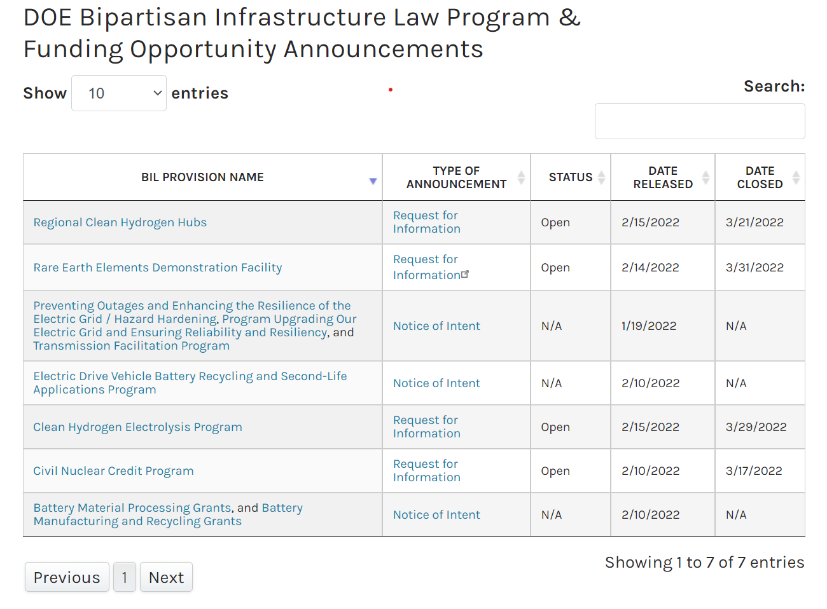
DOE FUNDING
BREAKDOWN
$75B BIL DOE Funding
($ millions)

Slide 31
FOLLOW THE $75B
INFORMATION & DATA LINKS
FUNDING MECHANISMS
RECIPIENTS
BIL PROGRAMS
BIL GUIDEBOOK
BIL FUNDING MECHANISMS & RECIPIENTS
This Photo by Unknown Author is licensed under CC BY-NC-ND

Slide 32
NAVIGATING THE MAZE
4 Steps
Identify your BIL energy program: existing or new program?
Honest self-analysis SWOT / mitigate weaknesses / why you?
Business intelligence & ”lay of the land”
Direct engagement

Slide 33
Questions?
Feel free to add them into the chat!
Contact us to get more info
example@gmail.com
https://www.linkedin.com/company/mid-tier-advocacy/
www.midtier.org

